Slide 1
Behavioral Design Patterns

Slide 2
Behavioral Patterns
Concerned with algorithms and the assignment of responsibilities between objects
They not only characterise objects/classes but also the patterns of communication between them.
They characterise complex control flow that’s difficult to follow at run-time

Slide 3
I have a problem…
I am working on collections of objects
At some point I need to go through a collection and process each element in that collection
My algorithm cannot be generic because different collection implementations make it difficult to access them uniformly
Stack
LinkedList
Client
BinaryTree
HashTable
Product
Database
Set

Slide 4
Iterator
Intent:
Provide a way to access the elements of an aggregate object sequentially without exposing its underlying representation.
Problem:
You work with different types of aggregate objects
The aggregate objects are not easily grouped under a superclass
You need uniform sequential access to elements in the aggregate objects. Sequence generation algorithms may need to be different for the same object. E.g. Getting a list of products ordered by price or ordered by name.
Applicability
When you need to access an aggregate object’s components without exposing its internal representation
When you need to support multiple traversals of aggregate objects
When you need to provide a uniform interface for traversing different types of objects.

Slide 5
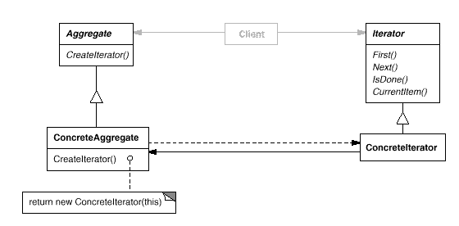
Iterator
Structure:

Slide 6
Iterator
Consequences:
Supports variations in the traversal of an aggregate: Complex aggregates may be traversed in many ways. For example, one may require the traversal of a tree using inorder and preorder algorithms.
Iterators simplify the aggregate interface: Since the iteration methods are outsourced to an iterator, the aggregate object’s interface is simplified.
More than one traversal can be pending on an aggregate: One could instantiate multiple iterators at will and thus have multiple concurrent traversals of the same structure.

Slide 7
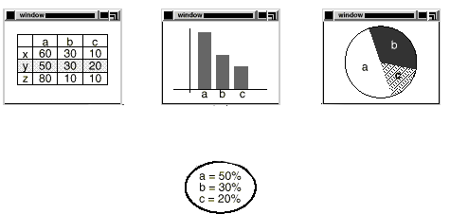
I have a problem…
I am writing a spreadsheet application
Whenever a value in a cell changes, it may have an effect on other cells or objects such as graphs
How do I efficiently make changes to individual cells affect related objects/cells?

Slide 8
Observer
Intent:
Define a one-to-many dependency between objects so that when one object changes state, all its dependents are notified and update automatically.
Problem:
Good OOP requires partitioning a system into a collection of cooperating classes.
You need to maintain consistency between these classes.
You cannot do it by making the classes tightly coupled because that reduces their reusability.
Applicability
When an abstraction has two aspects, one dependent on the other.
When a change to one object requires changing others and you don’t know how many need to be changed.
When you want to minimise coupling between dependent objects.

Slide 9
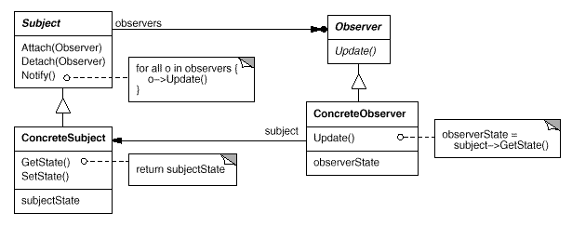
Observer
Structure:

Slide 10
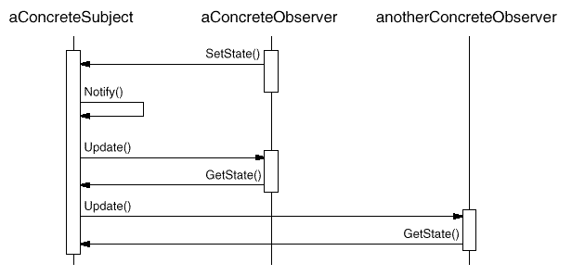
Observer
Interaction:

Slide 11
Observer
Consequences:
Abstract coupling between Subject and Observer: All a subject knows is that it has a list of observers, each conforming to a simple interface. It does not know the concrete class of any observer. Thus the coupling between subjects and observers is abstract and minimal.
Supports broadcast communication: Unlike an ordinary request, the notification that a subject sends needn’t specify its receiver. The notification is broadcast automatically.
Unexpected updates: Observers have no knowledge of each other’s presence. As a result they can be blind to the ultimate cost of changing the subject. A seemingly small update can cascade into multiple expensive operations.

Slide 12
I have a problem…
I am working on a complex user interface
Objects interact with each other. E.g. if a value of a particular field is zero, then another field will be disabled
The code for managing this is turning out to be very complex

Slide 13
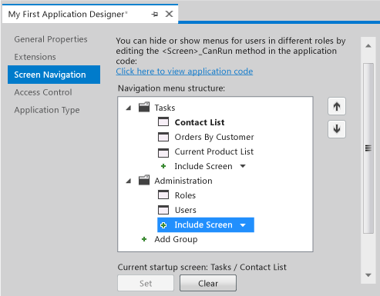
I have a problem…

Slide 14
Mediator
Intent:
Define an object that encapsulates how a set of objects interact. This promotes loose coupling by keeping objects from referring to each other explicitly.
Problem:
A good OOP system distributes behaviour amongst objects.
This can result in an object structure with many connections between objects.
Worst case: Every objects knows about every other object.
Applicability
When a set of objects communicate in well-defined but complex ways.
When reusing an object is difficult because it refers to and communicates with many other objects.
When a behaviour that’s distributed between several classes should be customisable without a lot of subclassing.

Slide 15
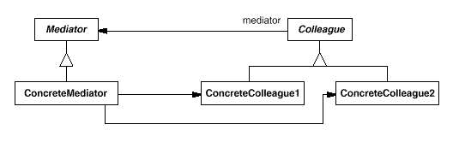
Mediator
Structure:

Slide 16
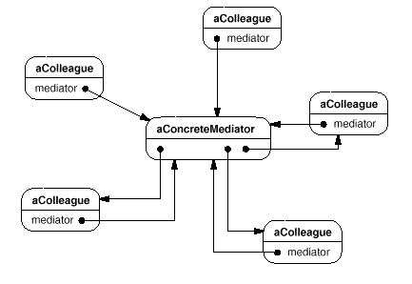
Mediator
Example instantiation:

Slide 17
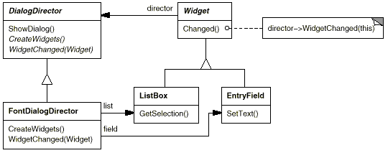
Mediator
A more concrete example:

Slide 18
Mediator
Consequences:
Decouples colleagues: Colleagues need not even be aware of each other. All the need to be aware of is the mediator.
Simplifies object protocols: The mediator replaces many-to-many interactions with one-to-many interactions between the mediator and its colleagues. These are easier to understand and maintain.
Centralises control: The mediator pattern trades complexity of interaction for complexity in the mediator. Depending on the balance, this can make things easier or can make the mediator a monolith that’s hard to maintain.

Slide 19
Conclusions
We have explored the notion of design patterns and covered a number of examples.
Design patterns reuse experience
Design patterns provide a common vocabulary amongst software engineers much like vocabulary in other fields
I encourage you to read up on design patterns which we have not covered here. You will find them very useful.

